Slide 1
Optimal Emission Reduction
Science and scenarios
Abatement costs
Instruments for emission reduction
Impacts of climate change; valuation
Economic impacts; marginals; distribution
Impacts and development
Adaptation policy
Optimal climate policy
Discounting, equity, uncertainty

Slide 2
Optimal Climate Policy
International agreements
First-best climate policy
Ancillary benefits
Time discounting
Uncertainty
Equity

Slide 3
How deep?
The ultimate objective of [the United Nations Framework Convention on Climate Change] [...] is to achieve [...] stabilization of greenhouse gas concentrations in the atmosphere at a level that would prevent dangerous anthropogenic interference with the climate system. Such a level should be achieved within a time-frame sufficient to allow ecosystems to adapt naturally, to ensure that food production is not threatened and to enable economic development to proceed in a sustainable manner.

Slide 4
How deep?
The ultimate objective of [the United Nations Framework Convention on Climate Change] [...] is to achieve [...] stabilization of greenhouse gas concentrations in the atmosphere at a level that would prevent dangerous anthropogenic interference with the climate system. Such a level should be achieved within a time-frame sufficient to allow ecosystems to adapt naturally, to ensure that food production is not threatened and to enable economic development to proceed in a sustainable manner.

Slide 5
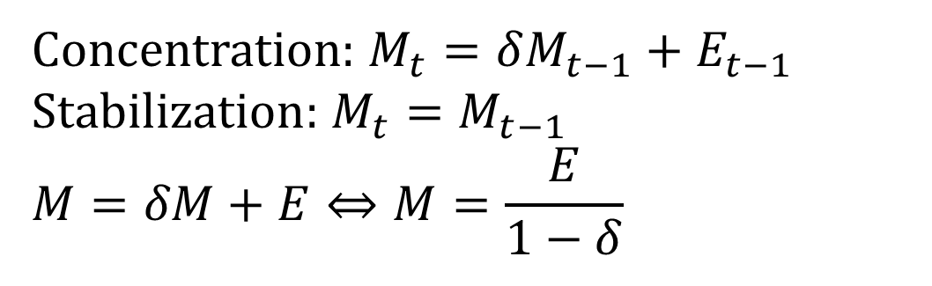
How deep?
Concentration: $M_{t}=δM_{t−1}+E_{t−1}$ $$\text{Stabilization}\text{: }M_{t}=M_{t−1} \\ M=δM+E⇔M=\frac{E}{1−δ}$$

Slide 6
How deep?
The ultimate objective of [the United Nations Framework Convention on Climate Change] [...] is to achieve [...] stabilization of greenhouse gas concentrations in the atmosphere at a level that would prevent dangerous anthropogenic interference with the climate system. Such a level should be achieved within a time-frame sufficient to allow ecosystems to adapt naturally, to ensure that food production is not threatened and to enable economic development to proceed in a sustainable manner.

Slide 7
How deep?
Concentration: $M_{t}=δM_{t−1}+E_{t−1}$ $$\text{Stabilization}\text{: }M_{t}=M_{t−1} \\ M=δM+E⇔M=\frac{E}{1−δ}$$

Slide 8
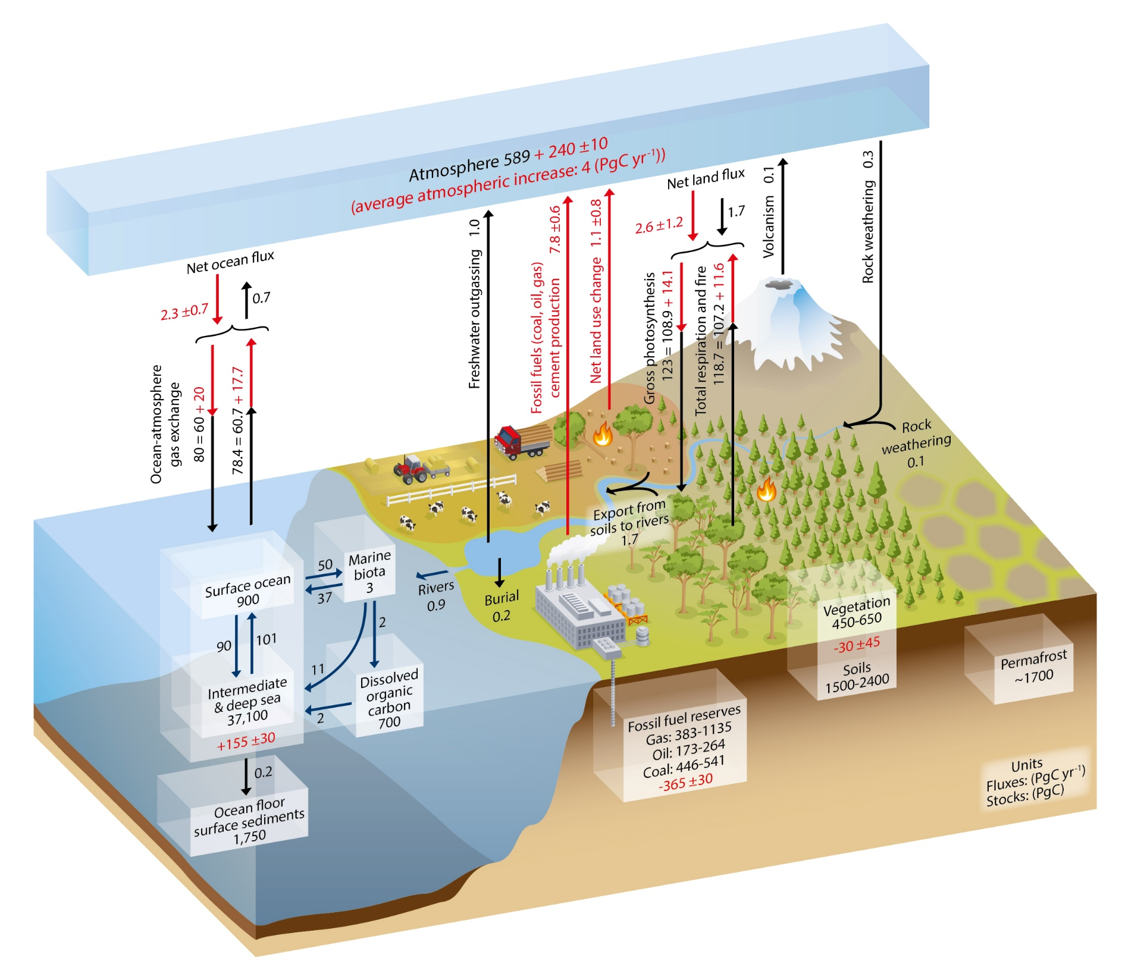

Slide 9
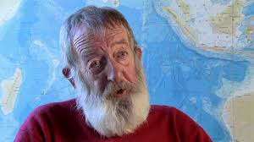
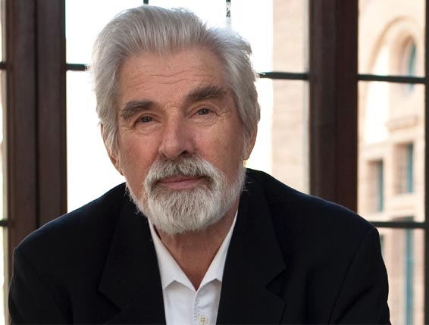

How deep?
Maier-Reimer & Hasselmann
$$M_{t}=\sum_{i=1}^{5}{M_{i,t}} \\ M_{i,t}=δ_{i}M_{i,t−1}+α_{i}E_{t−1};\sum_{i=1}^{5}{α_{i}}=1 \\ δ_{1}=1−1/2;δ_{2}=1−1/17;δ_{3}=1−1/74; \\ δ_{4}=1−1/363;δ_{5}=1$$

Slide 10
How deep?
Concentration: $M_{t}=δM_{t−1}+E_{t−1}$ $$\text{Stabilization}\text{: }M_{t}=M_{t−1} \\ M=δM+E⇔M=\frac{E}{1−δ}$$

Slide 11

How deep?
Maier-Reimer & Hasselmann
$$M_{t}=\sum_{i=1}^{5}{M_{i,t}} \\ M_{i,t}=δ_{i}M_{i,t−1}+α_{i}E_{t−1};\sum_{i=1}^{5}{α_{i}}=1 \\ δ_{1}=1−1/2;δ_{2}=1−1/17;δ_{3}=1−1/74; \\ δ_{4}=1−1/363;δ_{5}=1 \\ \text{Stabilization}\text{: }E=0$$

Slide 12
How deep?
The ultimate objective of [the United Nations Framework Convention on Climate Change] [...] is to achieve [...] stabilization of greenhouse gas concentrations in the atmosphere at a level that would prevent dangerous anthropogenic interference with the climate system. Such a level should be achieved within a time-frame sufficient to allow ecosystems to adapt naturally, to ensure that food production is not threatened and to enable economic development to proceed in a sustainable manner.

Slide 13
2015 Paris Agreement, Art 2(1)a
This Agreement […] aims to strengthen the global response to the threat of climate change […] by […] [h]olding the increase in the global average temperature to well below 2°C above pre-industrial levels and pursuing efforts to limit the temperature increase to 1.5°C above pre-industrial levels, recognizing that this would significantly reduce the risks and impacts of climate change;

Slide 14
Two degrees?
The 2K target was adopted by
the WBGU in 1995
the German government in 1995
the EU Council in 1996
President Obama in 2008
the UN in 2010
The 1.5K target of 2015 is an arbitrary number
The WBGU
Arbitrarily exaggerated economic impact estimates
Waved its hands at ecological impacts
Sought to safeguard creation (sic)
Argued that humankind cannot deviate too far from historical experience
Later justifications are flawed too

Slide 15
Optimal Climate Policy
International agreements
First-best climate policy
Ancillary benefits
Time discounting
Uncertainty
Equity

Slide 16

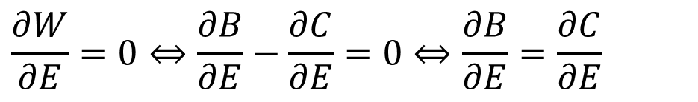
Optimal Climate Policy
In a static optimum, the marginal costs should equal the marginal benefits
$$\max_{E}W(E)=B(E)−C(E)$$
$$\frac{∂W}{∂E}=0⇔\frac{∂B}{∂E}−\frac{∂C}{∂E}=0⇔\frac{∂B}{∂E}=\frac{∂C}{∂E}$$

Slide 17
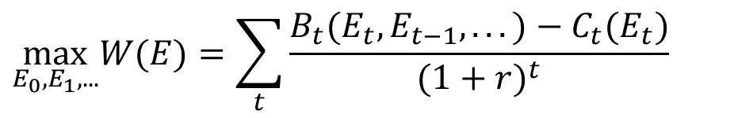
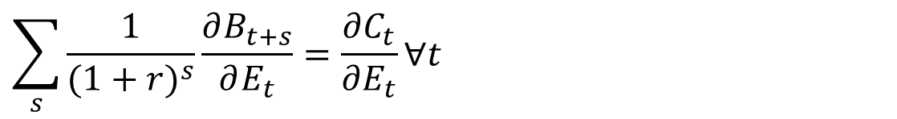
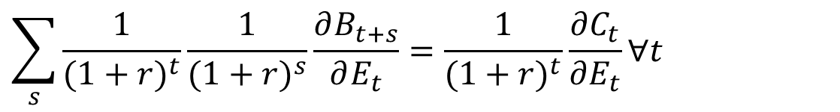
Optimal Climate Policy
In a situation like climate change, where the benefits are a stock and the costs are a flow, the marginal costs should equal the net present value of the marginal benefits
$$\max_{E_{0},E_{1},...}W(E)=\sum_{t}{\frac{B_{t}(E_{t},E_{t−1},...)−C_{t}(E_{t})}{(1+r)^{t}}}$$
$$\sum_{s}{\frac{1}{{(1+r)}^{t}}\frac{1}{(1+r)^{s}}\frac{∂B_{t+s}}{∂E_{t}}}=\frac{1}{{(1+r)}^{t}}\frac{∂C_{t}}{∂E_{t}}∀t$$
$$\sum_{s}{\frac{1}{(1+r)^{s}}\frac{∂B_{t+s}}{∂E_{t}}}=\frac{∂C_{t}}{∂E_{t}}∀t$$

Slide 22
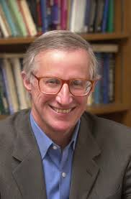
Optimal Emission Control
If the world were ruled by a benevolent dictator, what would she do?
A little emission reduction in the beginning, more later, but not enough to stabilise concentrations
The first part is robust

Slide 23
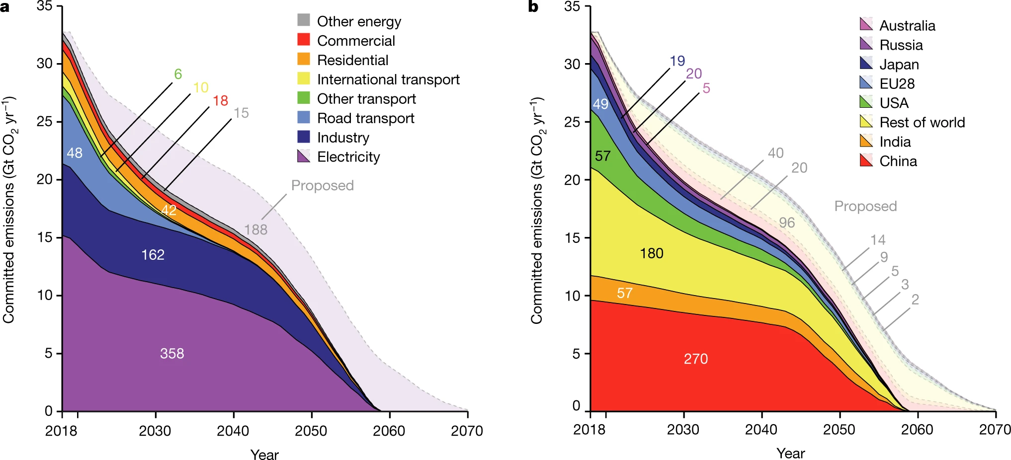
Committed emissions from existing and proposed energy infrastructure
(about 846 gigatonnes CO₂) thus represent more than the entire carbon
budget that remains if mean warming is to be limited to 1.5°C
with a probability of 66 to 50 per cent (420–580 gigatonnes CO₂),
and perhaps two-thirds of the remaining carbon budget if mean
warming is to be limited to less than 2 °C (1,170–1,500 gigatonnes CO₂).

Slide 24
Optimal Emission Control
If the world were ruled by a benevolent dictator, what would she do?
A little emission reduction in the beginning, more later, but not enough to stabilise concentrations
The first part is robust, the second part is very sensitive to assumptions
The last part is robust

Slide 25
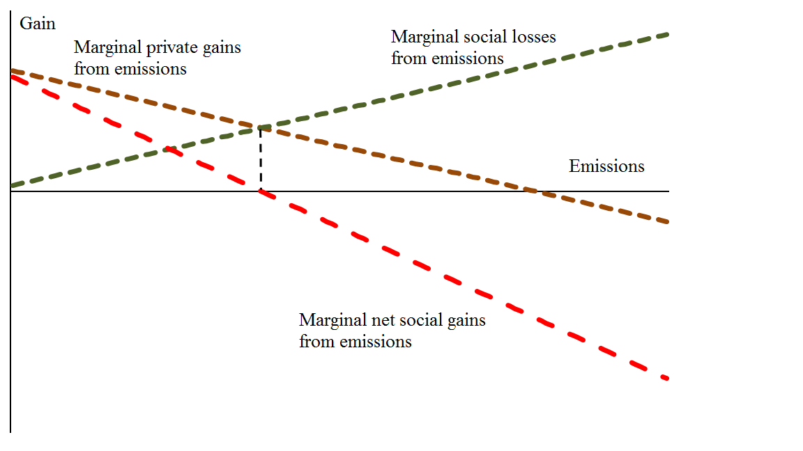

Slide 26
Optimal Emission Control
If the world were ruled by a benevolent dictator, what would she do?
A little emission reduction in the beginning, more later, but not enough to stabilise concentrations
The first part is robust, the second part is very sensitive to assumptions
The last part is robust, unless there is a carbon-free backstop

Slide 27
Carbon-free backstop
A carbon-free backstop is a source of energy that does not emit carbon dioxide
This backstop outcompetes fossil energy a certain carbon tax
The backstop does not just replace fossil energy at the margin, but it takes over the market – there is an abundant supply at a constant cost
The backstop continues to dominate the energy market even after the carbon tax has dropped back to zero

Slide 28
Optimal Emission Control
If the world were ruled by a benevolent dictator, what would she do?
A little emission reduction in the beginning, more later, but not enough to stabilise concentrations
The first part is robust, the second part is very sensitive to assumptions
The last part is robust, unless there is a carbon-free backstop

Slide 29
Optimal Emission Control
If the world were ruled by a benevolent dictator, what would she do?
A little emission reduction in the beginning, more later, but not enough to stabilise concentrations
The first part is robust, the second part is very sensitive to assumptions
The last part is robust, unless there is a carbon-free backstop
If we consider many countries, optimal emission reduction goes down!

